Slide 1
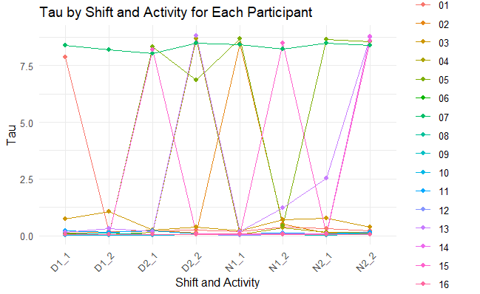
Consistently consistent
Inconsistent
Consistently inconsistent

